Slide 1
Happy Little ERS – An Employee Reimbursement System
Brandon Scoggins

Slide 2
Functionality
Login
Register
Employee and Management
Update user information
Create case
Logout

Slide 3
Functionality
Employee
View all owned cases
Manager
View all owned cases
Manage all non-owned cases
Sort cases by type and status

Slide 4
Tech Stack
Database – Oracle SQL Developer
DB Connection – Oracle Java Database Connection
Backend – Java
Frontend – JavaScript, Jquery, HTML, CSS, AJAX, JSON, jackson
Bootstrap Framework
Host - Tomcat

Slide 5
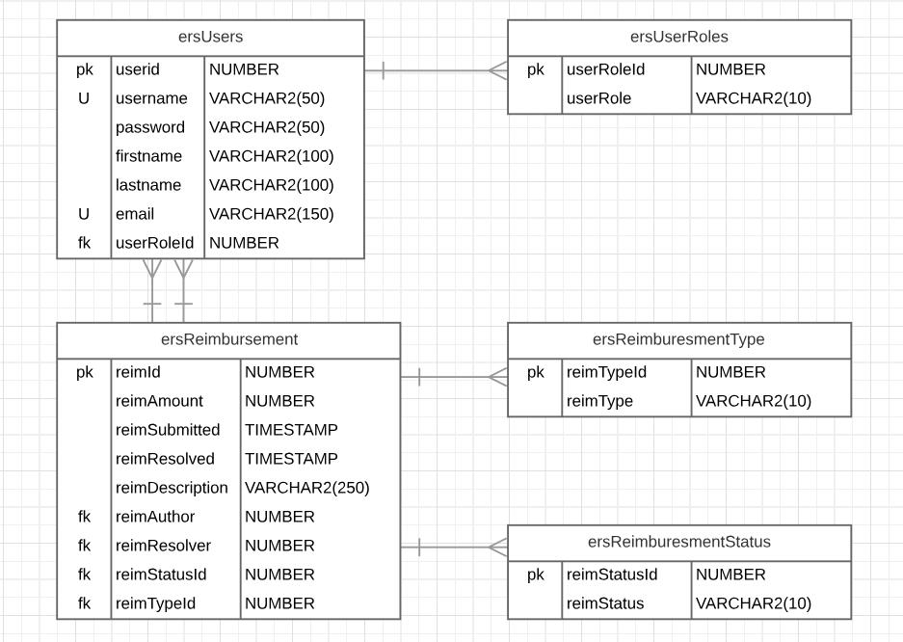
DataBase Diagram

Slide 6
User Stories
New employee will register then create some cases.
A manager will log in, view their own cases, then approve/deny non-owned cases
An employee will log in and see updated case statuses
Another manager will approve the first managers case

Slide 7
Questions?

